Slide 1

THE GIFT OF EXPERIENCE
Marketing Your Programs for the Holidays
Notes:
Hi everyone! Welcome to today’s session – part 4 of our 5 part series. Hi everyone! Welcome to today’s session – part 4 of our 5 part series. Today, we’re going to talk about why email is so important to the experience, and pump up the volume on your email skills and strategies.
Before we get started, I want to get a few housekeeping items out of the way:
For this webinar, you’ll view the main content in the slides area.
You can resize the slides window and any of the widgets within the console, so please
go ahead and take a moment to adjust the console if needed.
Throughout the webinar, you can interact live through the Question and Answer widget. There will be a few minutes at the end of the webinar to answer the questions that you submit.
Finally, there is a resource list to the left of the slide area. From there, you can download a lot of the resources we’re covering in the presentation today.
All of these widgets can be accessed without taking you away from or interrupting the webinar

Slide 2





Gift of Experience
Marketing for the Holidays
SENTIMENTAL
TRADITION
TIME TO REFLECT
UNDERSTANDING BUYER MOTIVATIONS
GUILT
STRESS
2
Notes:
Hi everyone! Welcome to today’s session – part 4 of our 5 part series. Hi everyone! Welcome to today’s session – part 4 of our 5 part series. Today, we’re going to talk about why email is so important to the experience, and pump up the volume on your email skills and strategies.
Before we get started, I want to get a few housekeeping items out of the way:
For this webinar, you’ll view the main content in the slides area.
You can resize the slides window and any of the widgets within the console, so please
go ahead and take a moment to adjust the console if needed.
Throughout the webinar, you can interact live through the Question and Answer widget. There will be a few minutes at the end of the webinar to answer the questions that you submit.
Finally, there is a resource list to the left of the slide area. From there, you can download a lot of the resources we’re covering in the presentation today.
All of these widgets can be accessed without taking you away from or interrupting the webinar

Slide 3

HOLIDAY SHOPPING BY THE NUMBERS
26%
Of shoppers start holiday shopping before Halloween!
The holiday shopping season kicks off earlier every year.
48%
Of shoppers will have done the majority of their shopping before Cyber Monday
2X
Parents are twice as likely to start early
$250
Parents spend on average $250 per child
3
Notes:
In addition to being one of the loveliest human beings I have ever met, Gina has schooled me in email best practices! She is my email guru. I thought I knew a thing or two about writing good email copy. That was until I had Gina edit one of my first drafts. When I got it back, it looked like a teacher with a red-pen had been through it, but in the best way possible! All of her comments and changes were so on-point. And to this day, I continue to channel the mantra ‘What would Gina do?
So today, we’re talking about email, because in the experience that your customers have with you, this is probably your CHIEF source of communication – and will continue to be even after they have left your program. Their EXPERIENCE will be shaped in large part by your communication, so it’s important to get that right!

Slide 4

ONLINE SHOPPING IS ON THE RISE
$93.8Billion
Was spent via online shopping during the 2016 holiday season! Up 14.3% from 2015.
Mobile search traffic eclipsed desktop during the holidays.
Over 33% of sales in 2017 came from mobile (up 3% from 2015)
16.4%
Increase in online shopping sales between 2016 and 2017
4

Slide 5

We Have a Lot of Stuff…
Startling Stats on What We Own
TOO MANY…
CLOTHES
The average family gets rid of over 200 pounds of clothes per year!
TOYS
3% of the world’s children live in the US, BUT they own 40% of the world’s toys
THINGS
There are 5x more storage facilities in the US than there are Starbucks
1 in 10 American homes uses a storage facility to store their excess stuff
54% of us report being overwhelmed by clutter
5
Notes:
Practice of dividing list into certain classifications
Update, new information
Consumers expect (and respond to) a high degree of customization
Generalized information increases unsubscribes
People recognize and start to trust you more over time

Slide 6

Start Marketing Now!
2018 Important Dates
START MARKETING NOW
Black Friday – November 23rd
Small Business Saturday – November 24th
Cyber Monday – November 26th
Super Saturday – December 22nd
Hanukkah – December 2nd – December 10th
Christmas Eve & Christmas – are on Monday & Tuesday this year, giving us one last chance to squeeze in one more weekend to shop.
6
Notes:
In addition to being one of the loveliest human beings I have ever met, Gina has schooled me in email best practices! She is my email guru. I thought I knew a thing or two about writing good email copy. That was until I had Gina edit one of my first drafts. When I got it back, it looked like a teacher with a red-pen had been through it, but in the best way possible! All of her comments and changes were so on-point. And to this day, I continue to channel the mantra ‘What would Gina do?
So today, we’re talking about email, because in the experience that your customers have with you, this is probably your CHIEF source of communication – and will continue to be even after they have left your program. Their EXPERIENCE will be shaped in large part by your communication, so it’s important to get that right!

Slide 7

1 | IDENTIFY YOUR AUDIENCE
2 | CREATE YOUR GIFT
3 | ROLLOUT YOUR CONTENT
PUT YOUR PLAN INTO ACTION
Notes:
Hi everyone! Welcome to today’s session – part 4 of our 5 part series. Hi everyone! Welcome to today’s session – part 4 of our 5 part series. Today, we’re going to talk about why email is so important to the experience, and pump up the volume on your email skills and strategies.
Before we get started, I want to get a few housekeeping items out of the way:
For this webinar, you’ll view the main content in the slides area.
You can resize the slides window and any of the widgets within the console, so please
go ahead and take a moment to adjust the console if needed.
Throughout the webinar, you can interact live through the Question and Answer widget. There will be a few minutes at the end of the webinar to answer the questions that you submit.
Finally, there is a resource list to the left of the slide area. From there, you can download a lot of the resources we’re covering in the presentation today.
All of these widgets can be accessed without taking you away from or interrupting the webinar

Slide 8

1
1
Identify Your Audience
IDENTIFY YOUR AUDIENCE
8
Notes:
In addition to being one of the loveliest human beings I have ever met, Gina has schooled me in email best practices! She is my email guru. I thought I knew a thing or two about writing good email copy. That was until I had Gina edit one of my first drafts. When I got it back, it looked like a teacher with a red-pen had been through it, but in the best way possible! All of her comments and changes were so on-point. And to this day, I continue to channel the mantra ‘What would Gina do?
So today, we’re talking about email, because in the experience that your customers have with you, this is probably your CHIEF source of communication – and will continue to be even after they have left your program. Their EXPERIENCE will be shaped in large part by your communication, so it’s important to get that right!

Slide 9

Identify Your Audience
Segmenting & Motivation
IDENTIFY YOUR AUDIENCE
How should we segment buyers?
New vs. Returning customers
Early buyers
By child age/sport/gender
Determine what works for you!
What motivates your buyers?
Why do they register?
What will they gain?
How are you different?
9
Notes:
In addition to being one of the loveliest human beings I have ever met, Gina has schooled me in email best practices! She is my email guru. I thought I knew a thing or two about writing good email copy. That was until I had Gina edit one of my first drafts. When I got it back, it looked like a teacher with a red-pen had been through it, but in the best way possible! All of her comments and changes were so on-point. And to this day, I continue to channel the mantra ‘What would Gina do?
So today, we’re talking about email, because in the experience that your customers have with you, this is probably your CHIEF source of communication – and will continue to be even after they have left your program. Their EXPERIENCE will be shaped in large part by your communication, so it’s important to get that right!

Slide 10

2
2
Create Your Gift
CREATE YOUR GIFT
10
Notes:
In addition to being one of the loveliest human beings I have ever met, Gina has schooled me in email best practices! She is my email guru. I thought I knew a thing or two about writing good email copy. That was until I had Gina edit one of my first drafts. When I got it back, it looked like a teacher with a red-pen had been through it, but in the best way possible! All of her comments and changes were so on-point. And to this day, I continue to channel the mantra ‘What would Gina do?
So today, we’re talking about email, because in the experience that your customers have with you, this is probably your CHIEF source of communication – and will continue to be even after they have left your program. Their EXPERIENCE will be shaped in large part by your communication, so it’s important to get that right!

Slide 11

Create Your Gift
Registration and Gift Certificates
CREATE YOUR GIFT
OPTION 1: Get Registration Up & Running!
Open registration for your upcoming programs
Offer limited or exclusive registration through the holidays
Provide time-sensitive discounts or exclusive gear/merchandise
OPTION 2: Create a ‘Gift Certificate’ Option
Perfect if your programs aren’t finalized!
Great opportunity for grandparents, friends & relatives
Can also include a special offer, early registration access or ‘stocking stuffer’
11
Notes:
In addition to being one of the loveliest human beings I have ever met, Gina has schooled me in email best practices! She is my email guru. I thought I knew a thing or two about writing good email copy. That was until I had Gina edit one of my first drafts. When I got it back, it looked like a teacher with a red-pen had been through it, but in the best way possible! All of her comments and changes were so on-point. And to this day, I continue to channel the mantra ‘What would Gina do?
So today, we’re talking about email, because in the experience that your customers have with you, this is probably your CHIEF source of communication – and will continue to be even after they have left your program. Their EXPERIENCE will be shaped in large part by your communication, so it’s important to get that right!

Slide 12

3
3
Rollout Your Content
ROLLOUT YOUR CONTENT
12

Slide 13
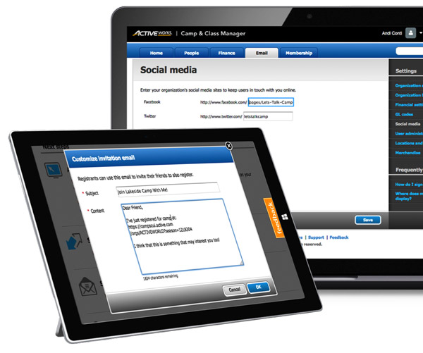
Rollout Your Content
Social Media
SOCIAL MEDIA
SCHEDULE CONTENT POSTS
Don’t come out of a hiatus with just promotions!
Social is great for building buzz and anticipation – countdown to the holidays, use hashtags & themes
LEVERAGE YOUR NETWORKS
Use personal pages to share posts, content and promotions
Try Closed Groups to communicate with your best customers/biggest fans
LOOK & FEEL
Now is a good time to update your cover photos, profile pictures and create seasonal images/memes
13

Slide 14
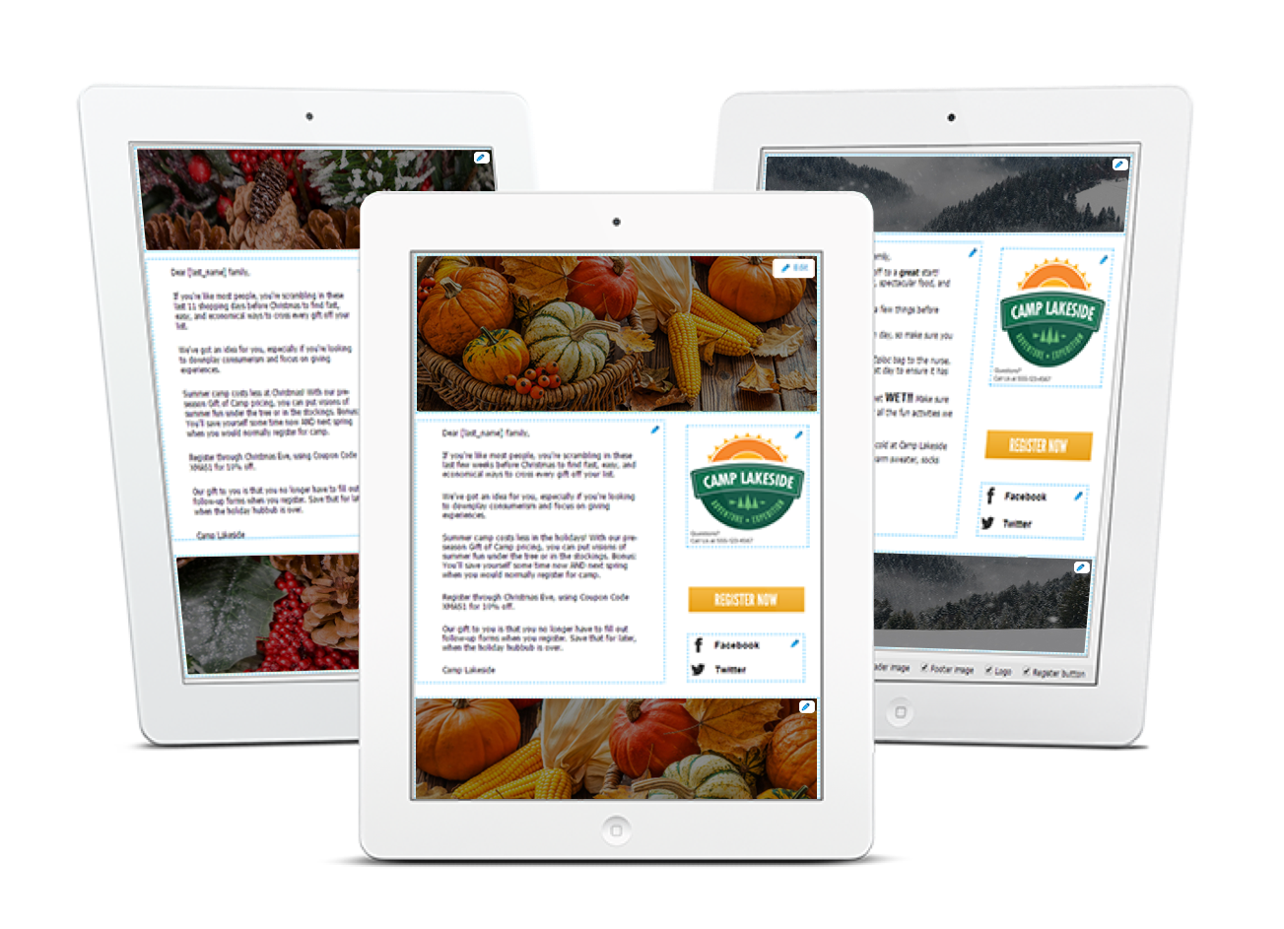
Rollout Your Content
Email Marketing
EMAIL MARKETING
STRIKE UP THE CONVERSATION NOW
Don’t come out of a hiatus with just promotions! Start with relevant content, a newsletter – or ‘Thank You’ timed with Thanksgiving
REMEMBER THE 5S RULES OF EMAIL
Segmented, Short, Strong Subject, Singular CTA, Suited to Mobile
TIMING MATTERS
Schedule emails ahead of key shopping dates
Send reminder emails the day before
Emails sent in the morning mid-week generally receive higher open rates
27%
Of sales are driven through Black Friday email marketing
14
Notes:
Benefits
Implement email marketing with easy-to-use, built-in templates that include your branding
Drive registrations and loyalty with dynamic recipient lists
Easily see open, sent and number of registrations from our email report
Get customized marketing assistance specific to your industry, focused on digital marketing and optimization recommendations
60% body language, 30% tone level of empathy, 10% what you are saying= 100% in person
40% communication= overal tone-> purpose and int
Implement email marketing with easy-to-use built-in templates that include your branding
Easily see open, sent and number of registrations from the email report
Ent
TIP: Create a dynamic recipient list in Camp & Class Manager to see which participants have yet to register for the same session in 2017. You can send a reminder to parents letting them know that this would be a great gift that grandparents, family and friends can give to the child.

Slide 15
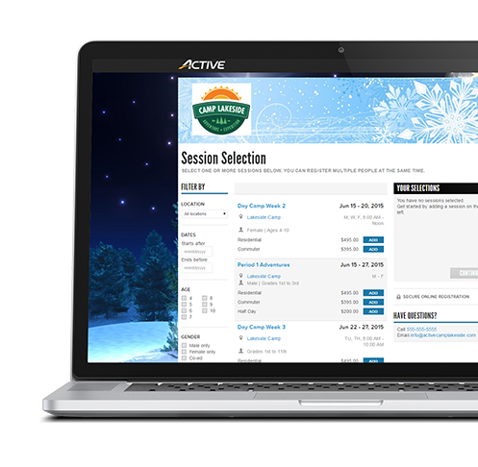
Rollout Your Content
Website
WEBSITE
UPDATE YOUR SITE CONTENT
Add holiday promotions, video messages, announcements etc. to high traffic site areas
Place registration buttons ‘above the fold’
Change your website banner to a holiday theme
Customize your registration form header & footer
Post holiday messages or videos
PROVIDE GIFT CERTIFICATES
Attach printable Gift Certificates to confirmation emails
LOOK & FEEL
Say ‘no’ to Comic Sans: FontSquirrel (free!)
Actually cool design templates: Canva.com
Free Stock Photos (that aren’t terrible!): StockSnap.io, Unsplash or Pexels
15
Notes:
Benefits
Implement email marketing with easy-to-use, built-in templates that include your branding
Drive registrations and loyalty with dynamic recipient lists
Easily see open, sent and number of registrations from our email report
Get customized marketing assistance specific to your industry, focused on digital marketing and optimization recommendations
60% body language, 30% tone level of empathy, 10% what you are saying= 100% in person
40% communication= overal tone-> purpose and int
Implement email marketing with easy-to-use built-in templates that include your branding
Easily see open, sent and number of registrations from the email report
ent

Slide 16
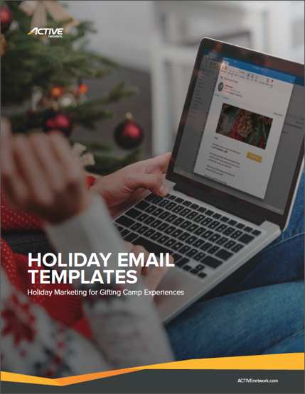
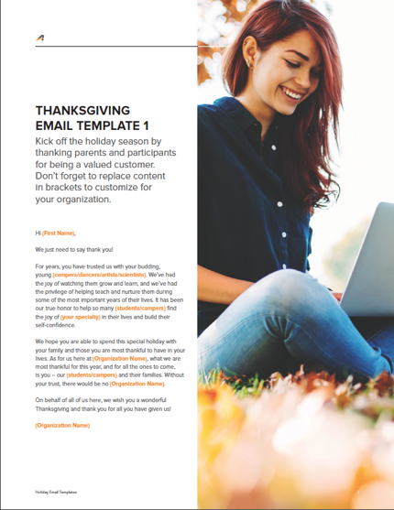
Rollout Your Content
Gift to You
OUR GIFT TO YOU!
Download your Holiday Email Templates Pack from the Resources section and get started on your holiday marketing right away!
3 Holiday Banners and Footers to dress up your emails
8 pre-written email templates
16
Notes:
Benefits
Implement email marketing with easy-to-use, built-in templates that include your branding
Drive registrations and loyalty with dynamic recipient lists
Easily see open, sent and number of registrations from our email report
Get customized marketing assistance specific to your industry, focused on digital marketing and optimization recommendations
60% body language, 30% tone level of empathy, 10% what you are saying= 100% in person
40% communication= overal tone-> purpose and int
Implement email marketing with easy-to-use built-in templates that include your branding
Easily see open, sent and number of registrations from the email report
ent

Slide 17

Gift of Experience
Thank You
THANK YOU
Ready to kick-off the holidays?
Contact us to get started!
17
Notes:
AE Contact info

